Slide 1

Local Hangout
Project Title
By Ngan Nguyen

Slide 2
If you're moving to a new city, it can be an intimidating and lonely experience. While moving for school comes with in-built structure and social systems, picking up and moving your life in your 20s and 30s, for work, a relationship or something else, is less adventure, more potential isolation. The possibility alone is daunting — Local Hangout will help you to make new group of friend that have the same interest.
Introduction

Slide 3
Being
Being bored
Being
Being disconnected
Being
Being lonely
Lack
Lack of social interaction can cause anxiety and depression
Problem Addressing

Slide 4
Mental wellbeing
Good for group activity
Networking
Benefit from Local Hangout

Slide 5
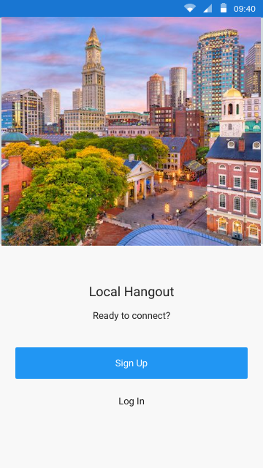
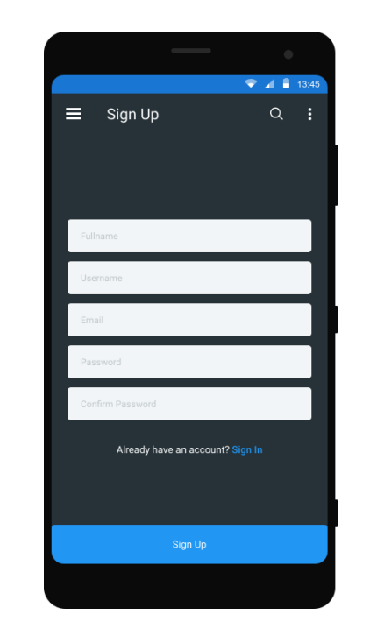

Slide 6
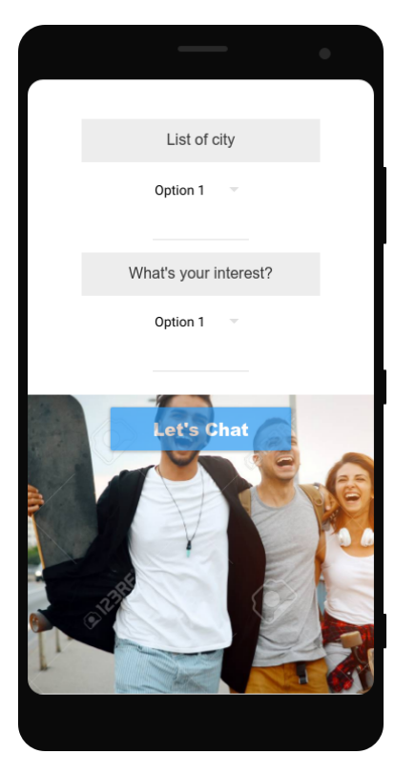
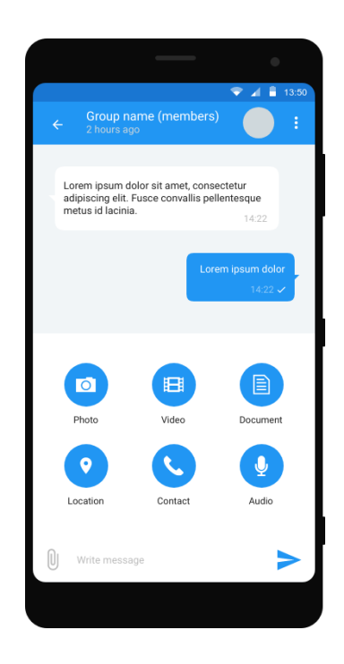

Slide 7
Feature
Users can choose the city where they are at so every time they are at a different city they can just choose a different location
After choosing the city, user can pick one of their interest and then click on the chat button to go into chat room
People who has the same interest for example yoga will be put in the Yoga group

Slide 8

Conclusion
Local Hangout can help improving your social life. Stay connecting and have fun making friends!!!

